Slide 1
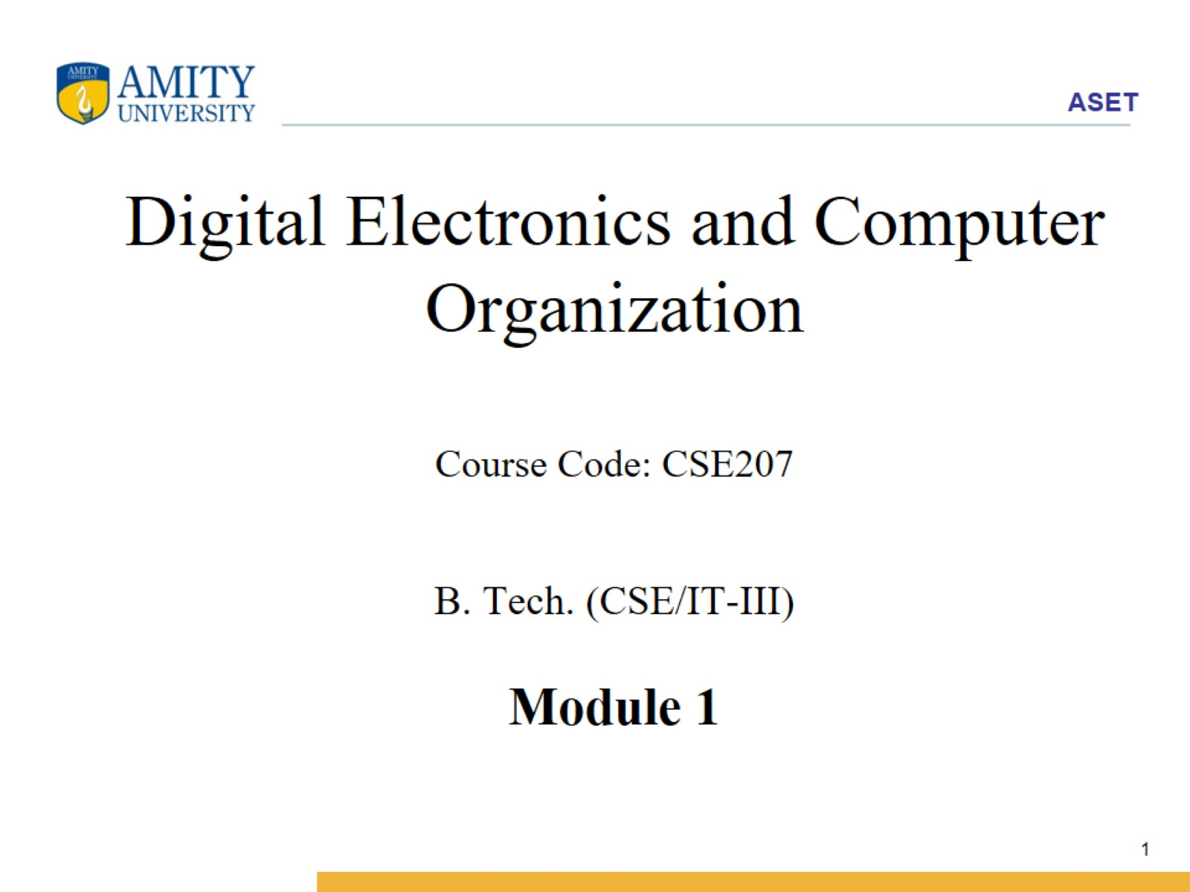
Digital Electronics and Computer Organization Course Code: CSE207 B. Tech. (CSE/IT-III) Module 1

Slide 2
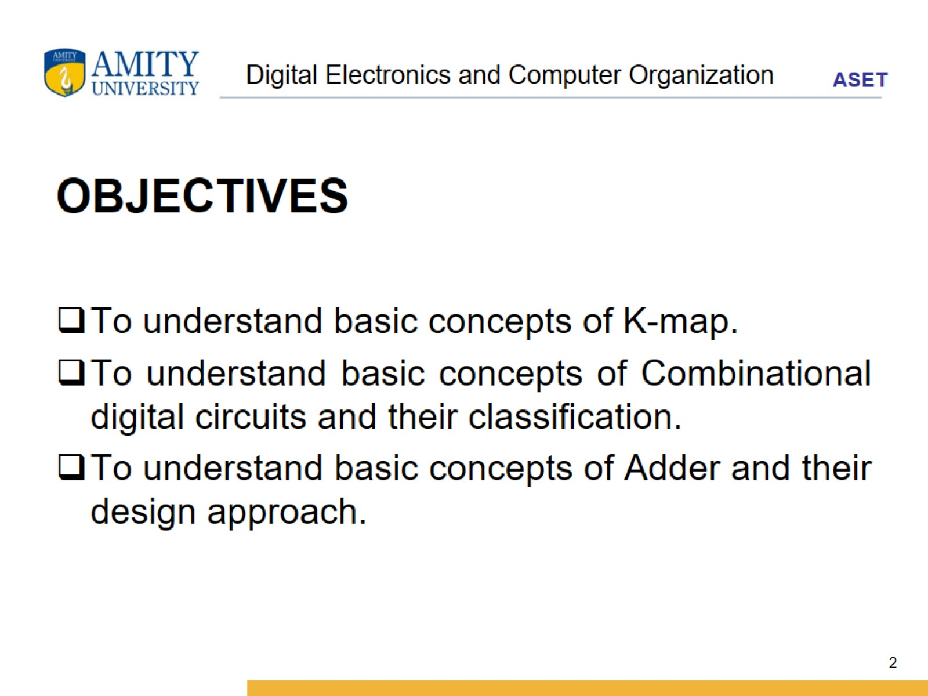
Digital Electronics and Computer Organization

Slide 3
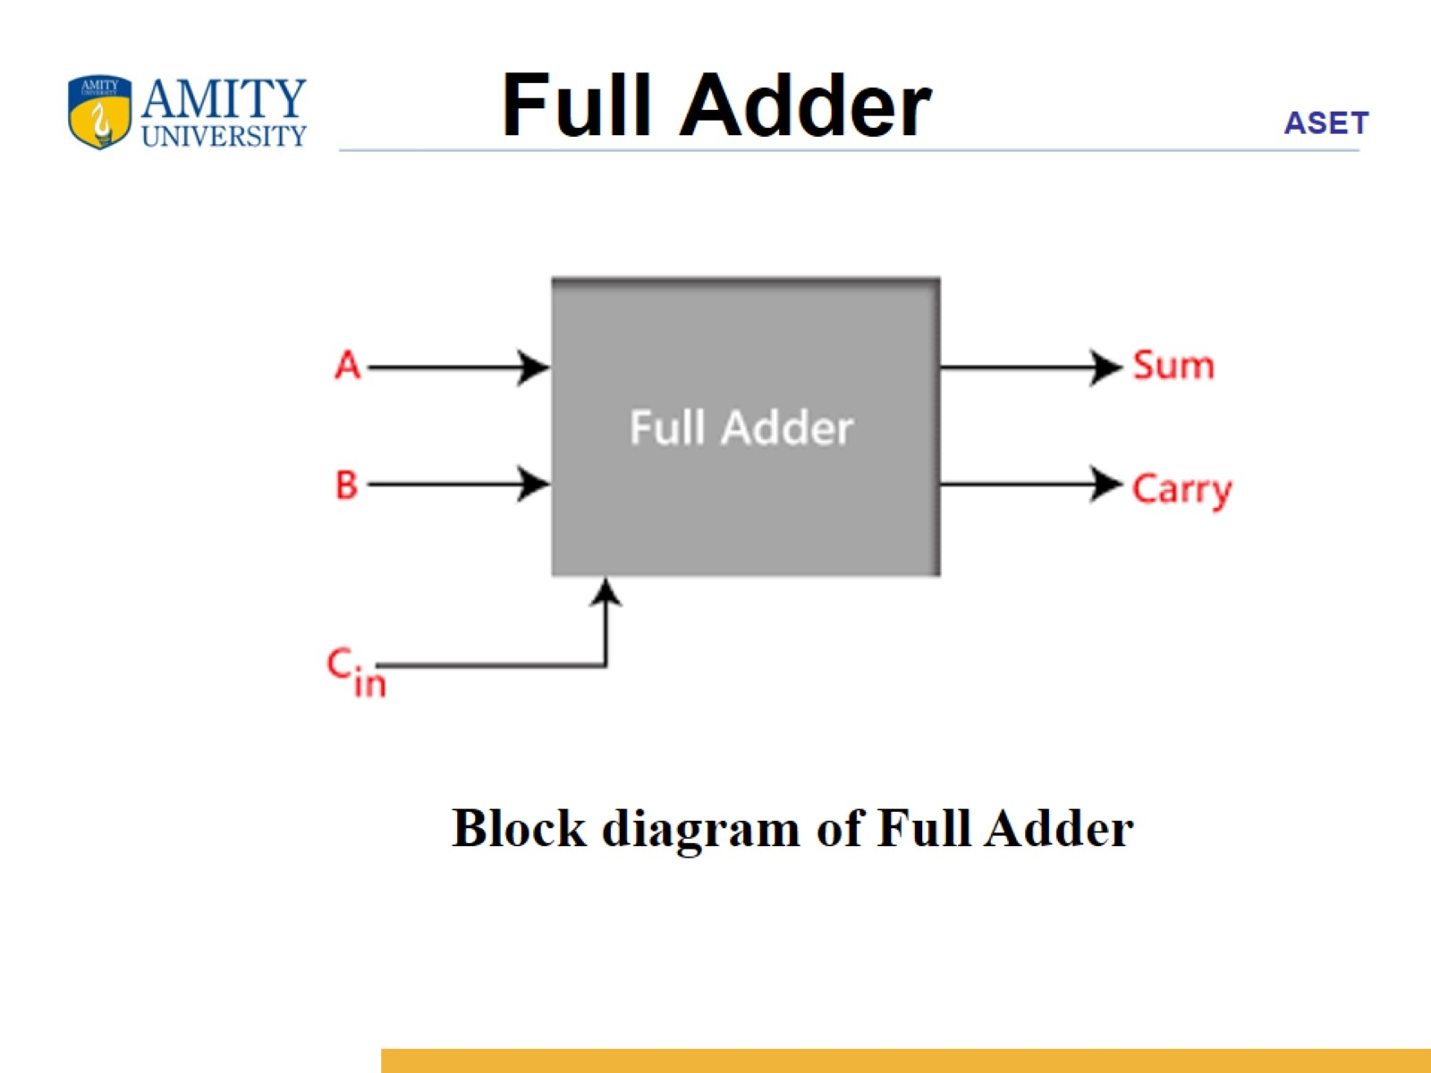
Full Adder

Slide 4
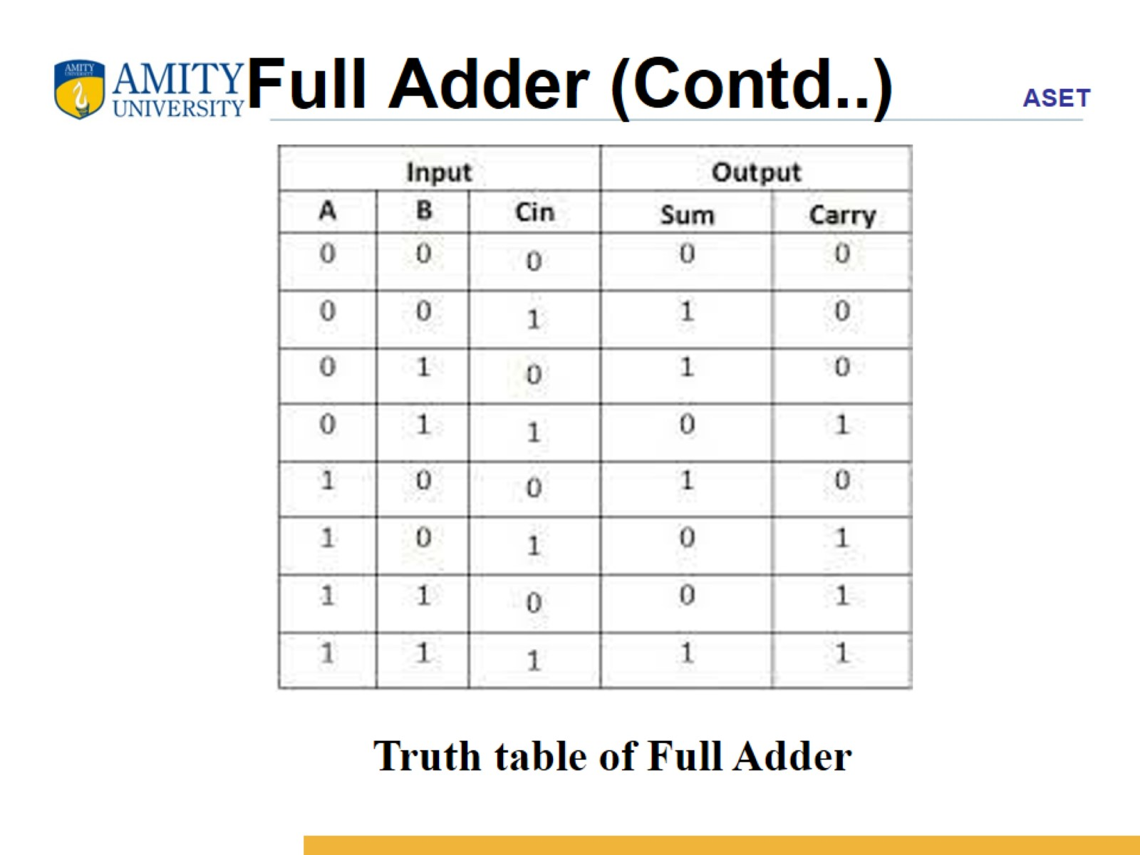
Full Adder (Contd..)

Slide 5
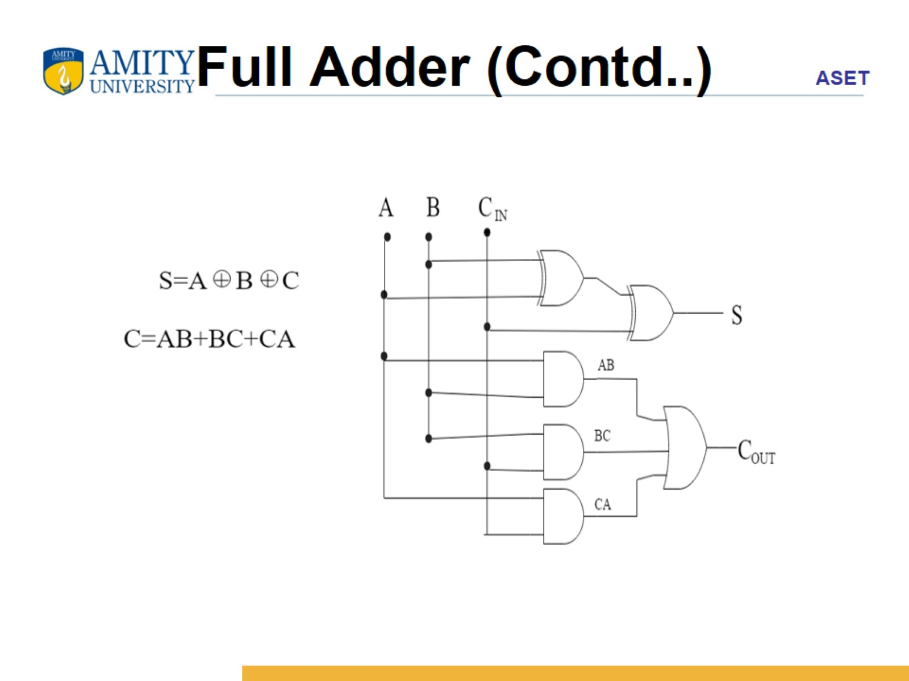
Full Adder (Contd..)

Slide 6
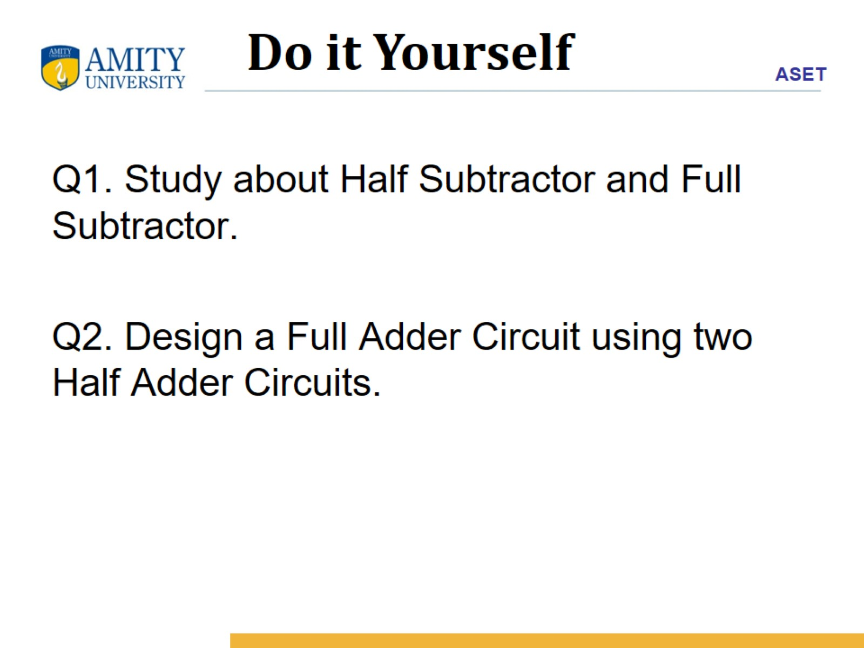

Slide 7
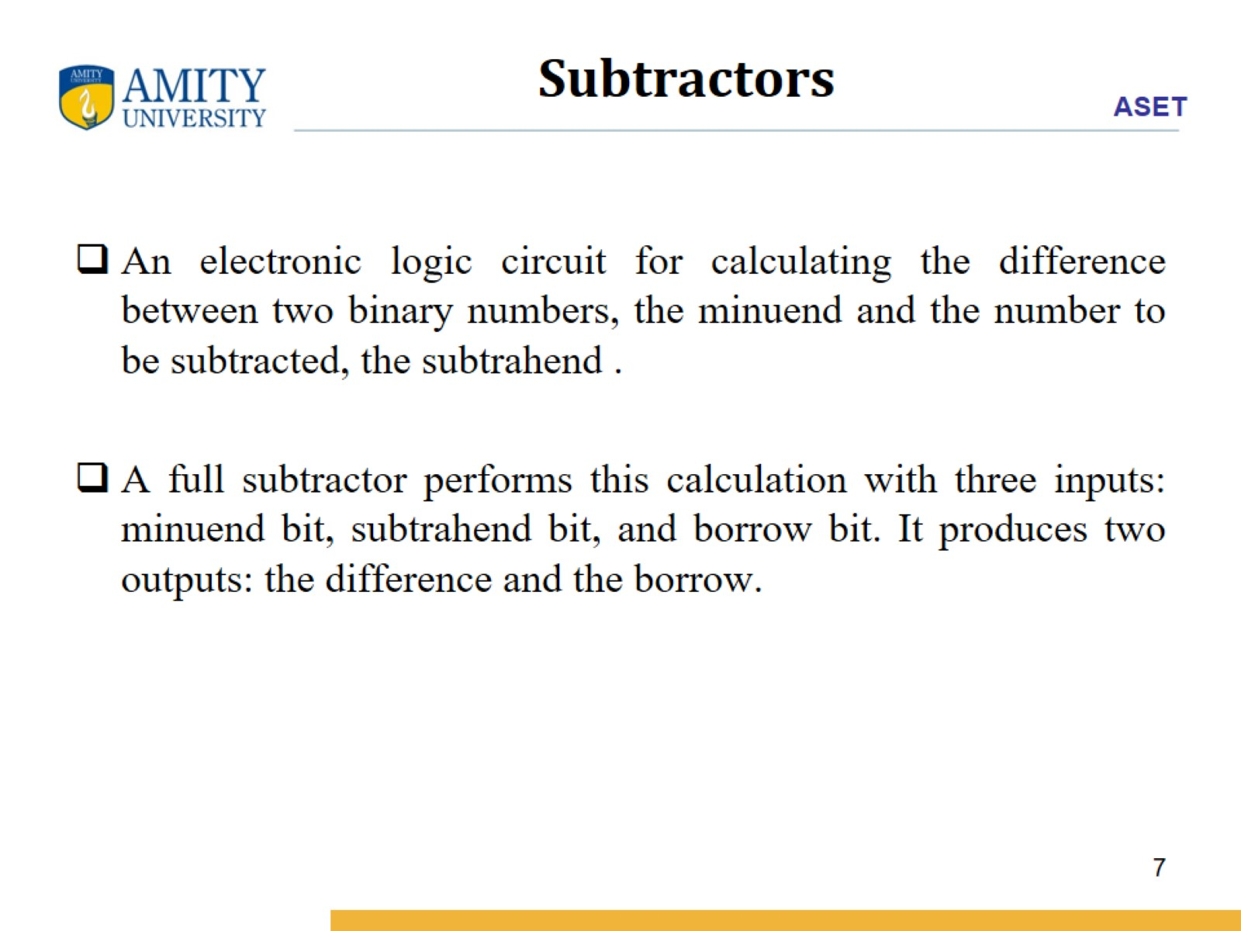
Subtractors

Slide 8
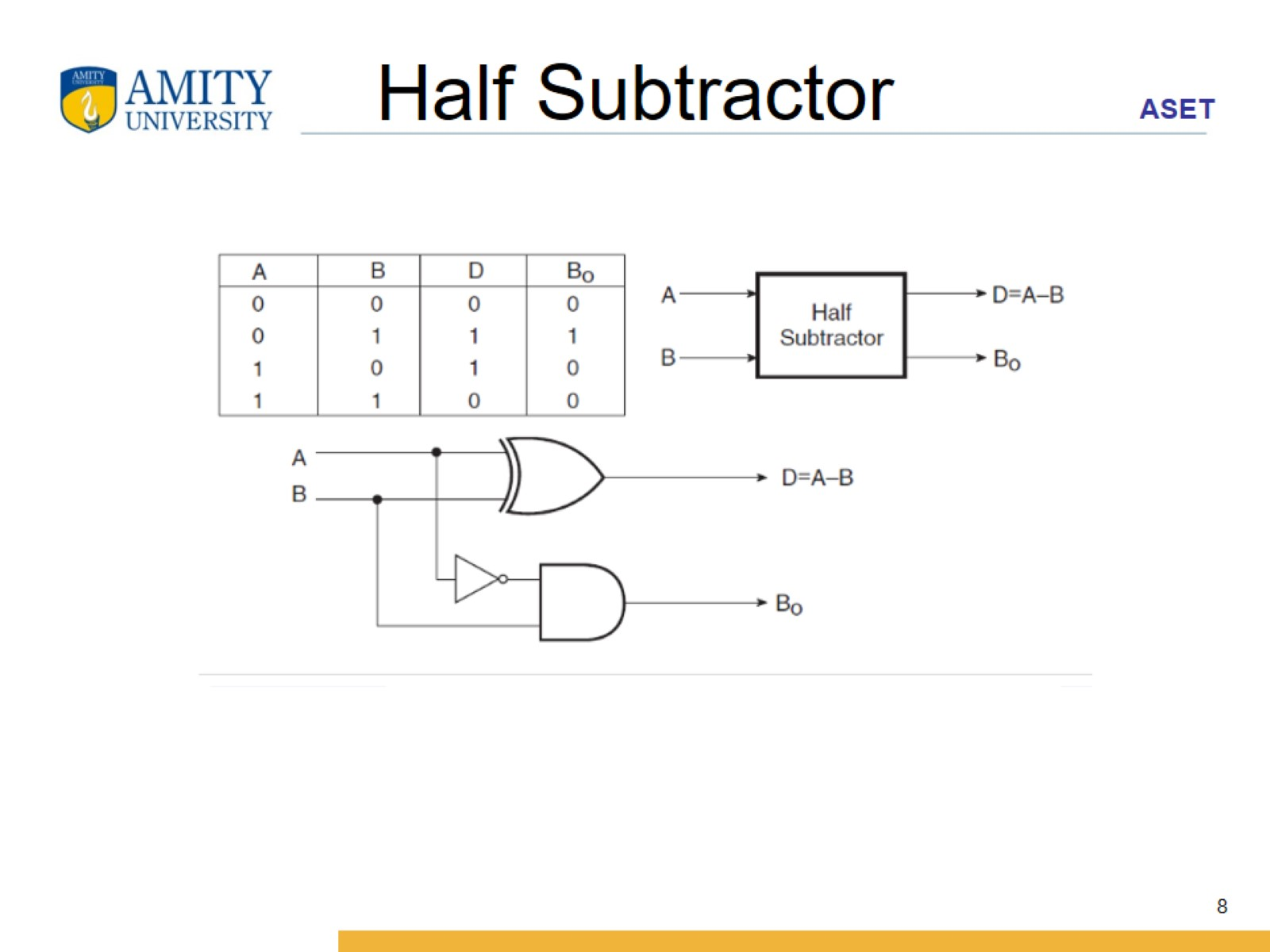
Half Subtractor

Slide 9
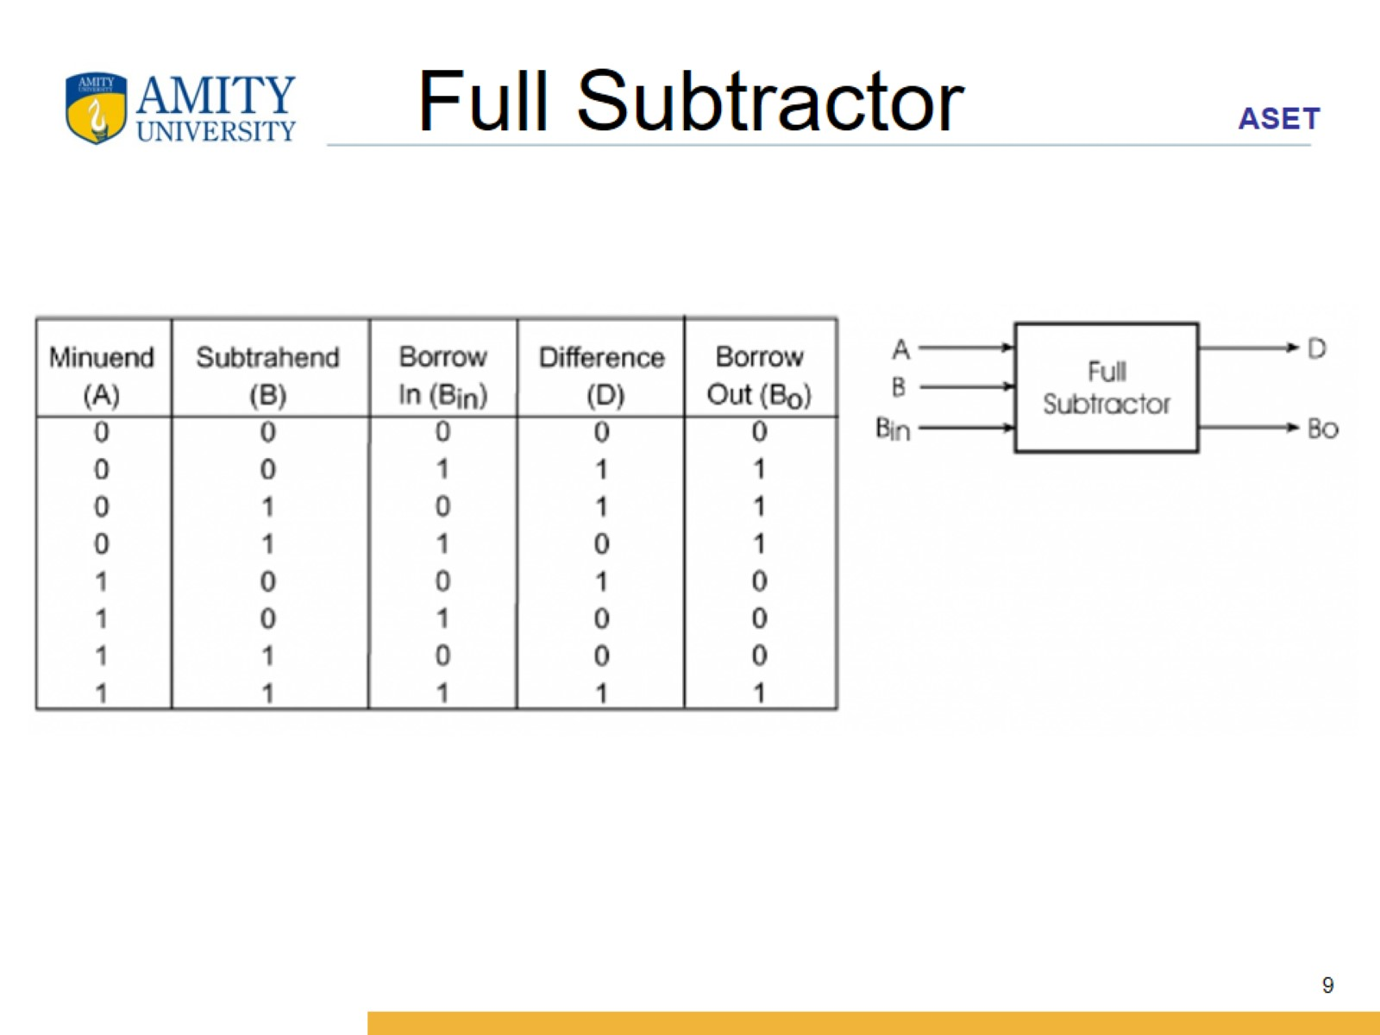
Full Subtractor

Slide 10
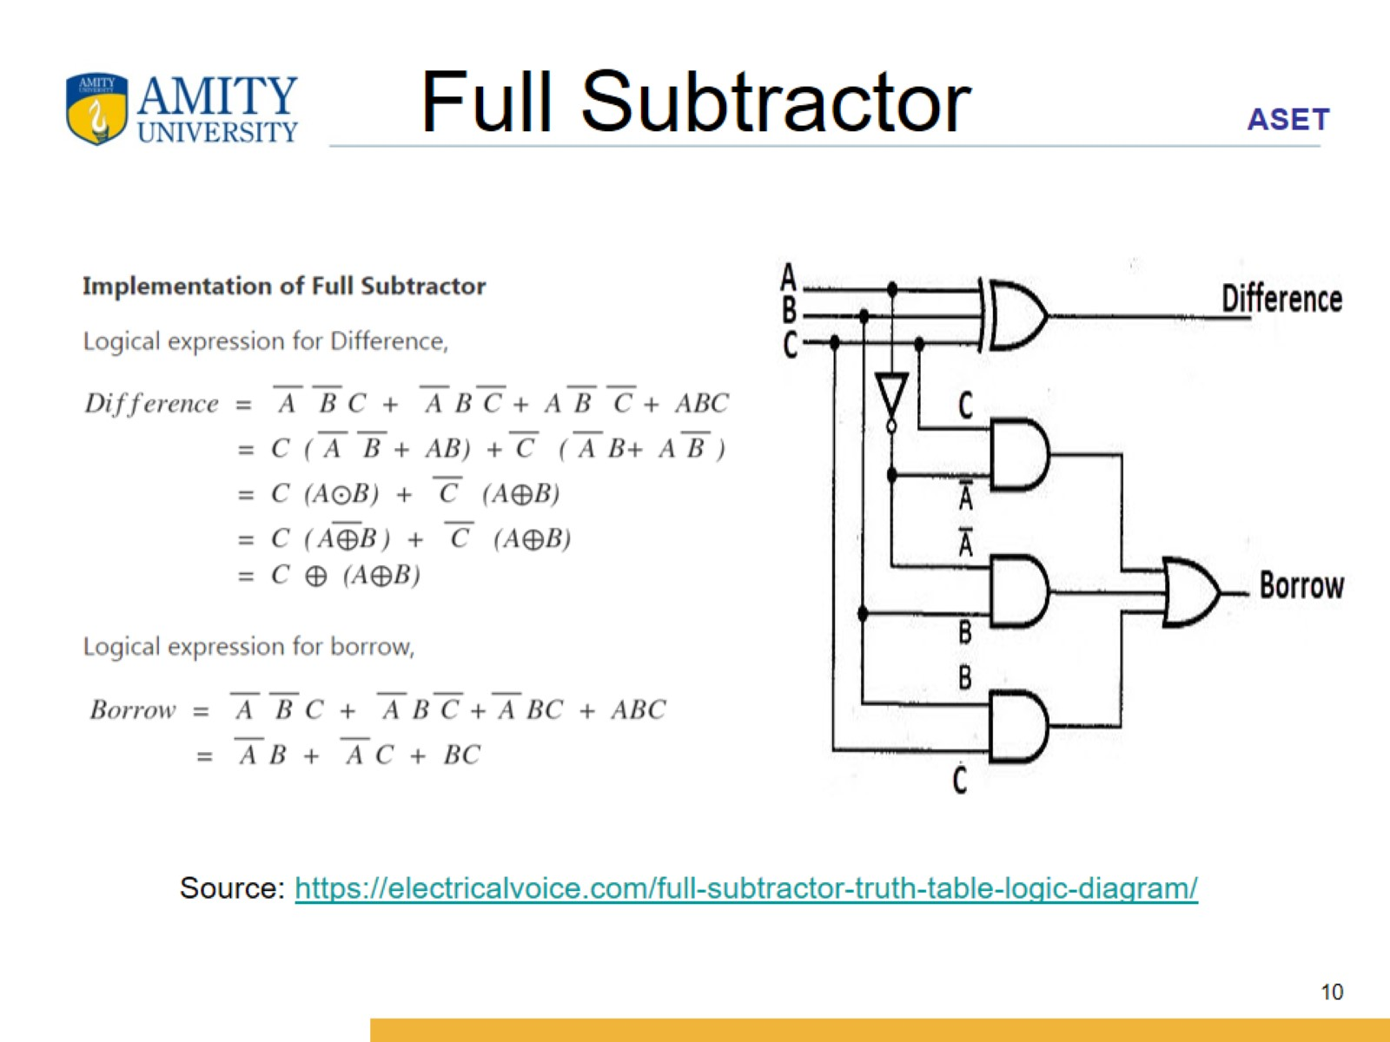
Full Subtractor

Slide 11
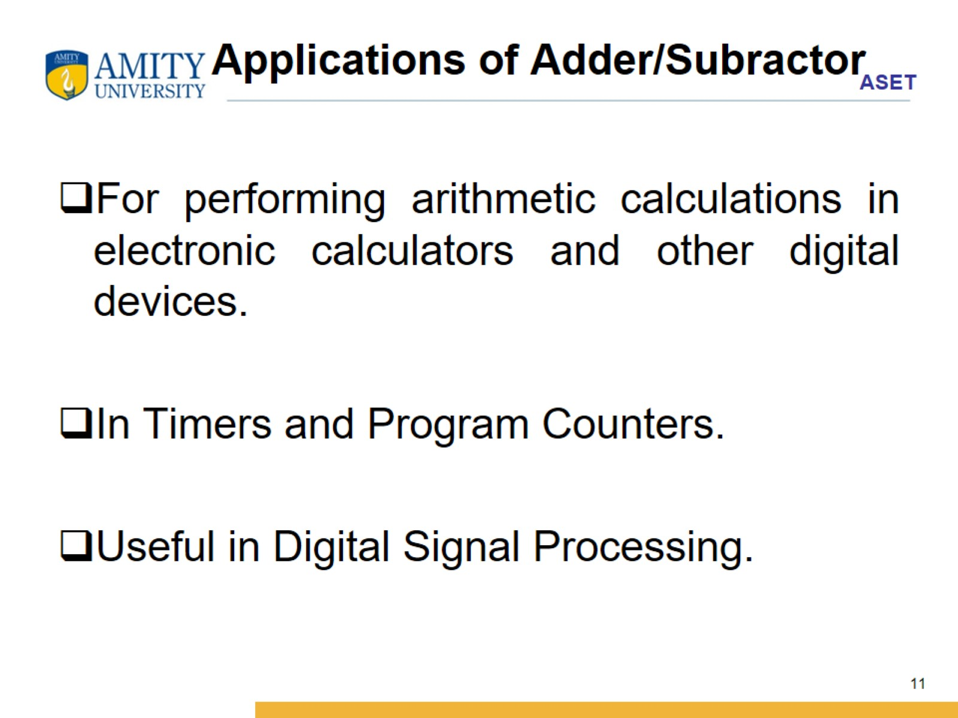
Applications of Adder/Subractor

Slide 12
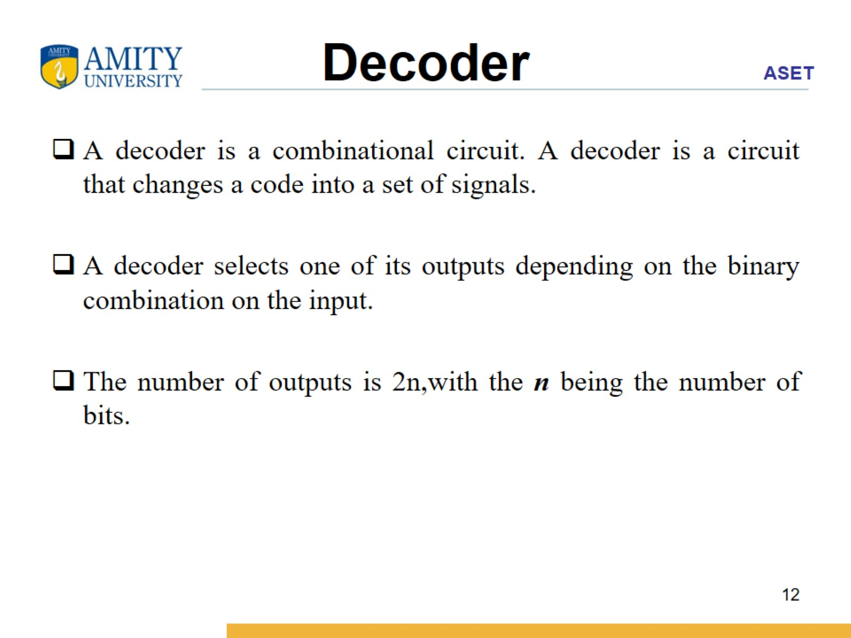
Decoder

Slide 13
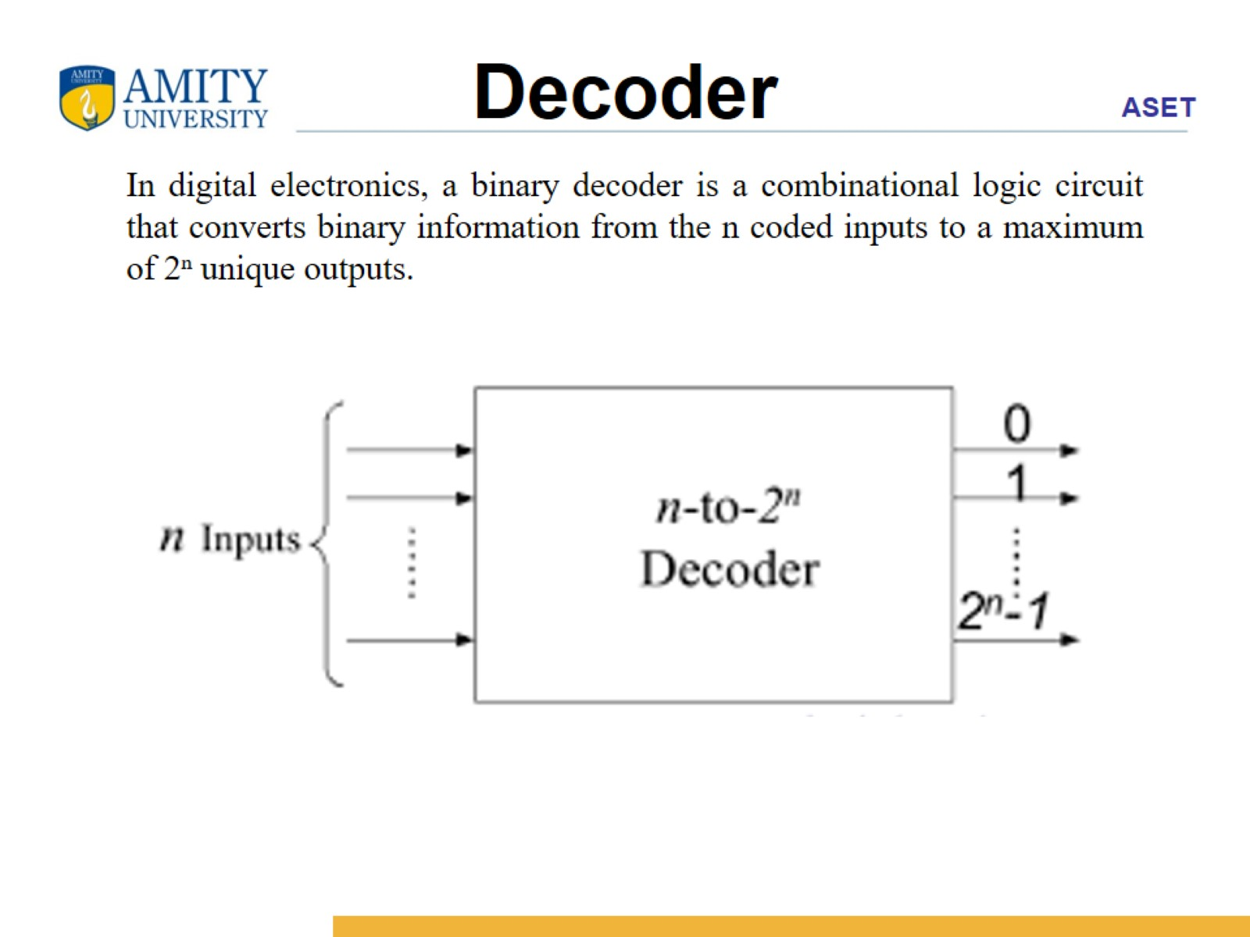
Decoder

Slide 14
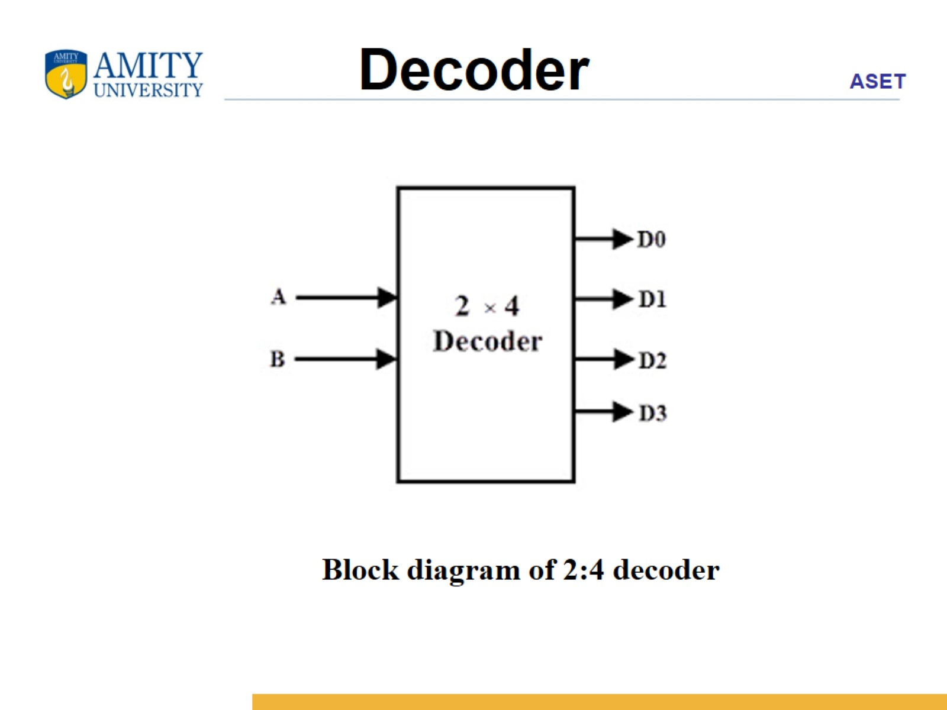
Decoder

Slide 15
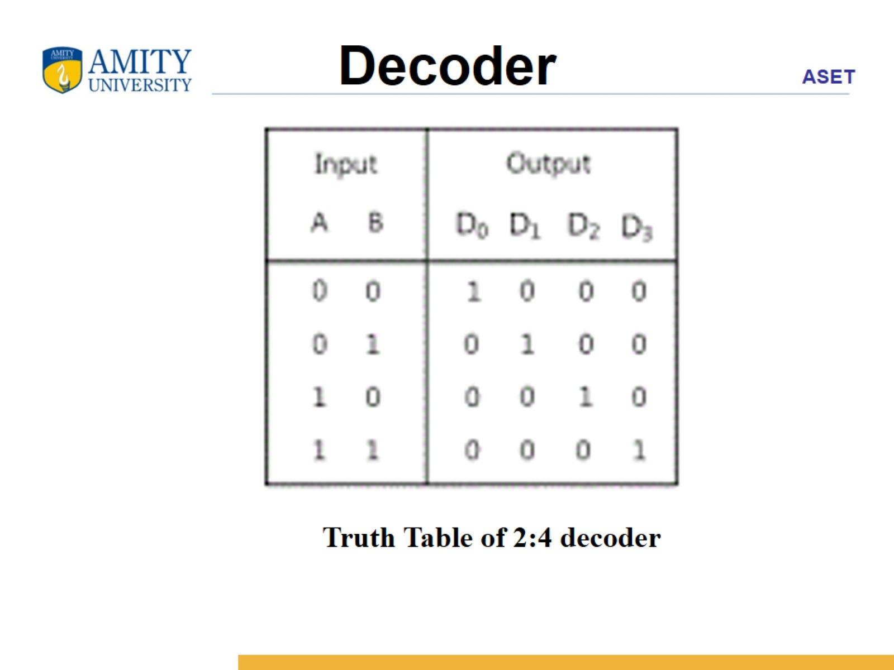
Decoder

Slide 16
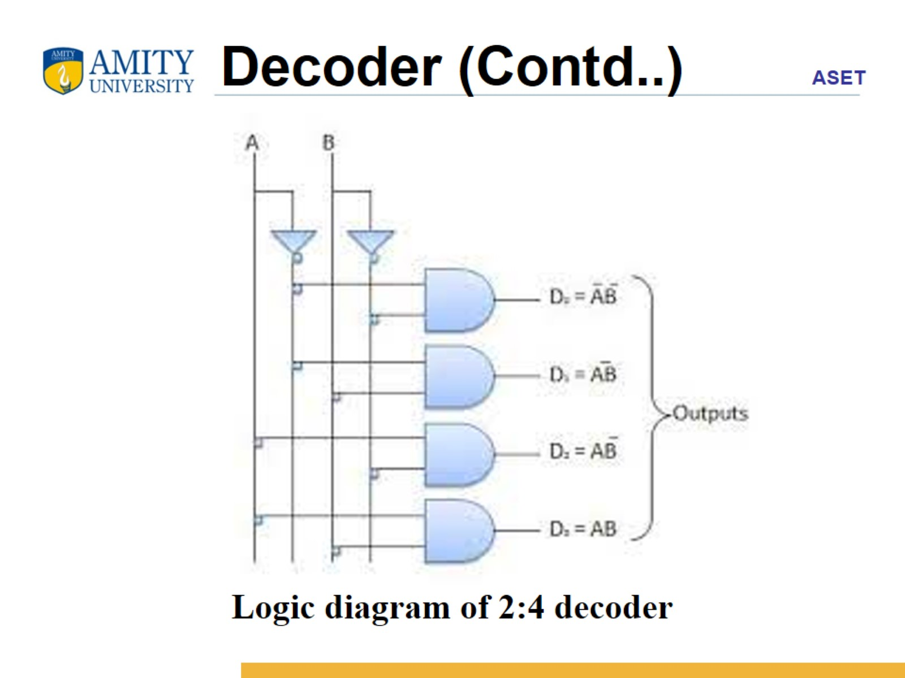
Decoder (Contd..)

Slide 17
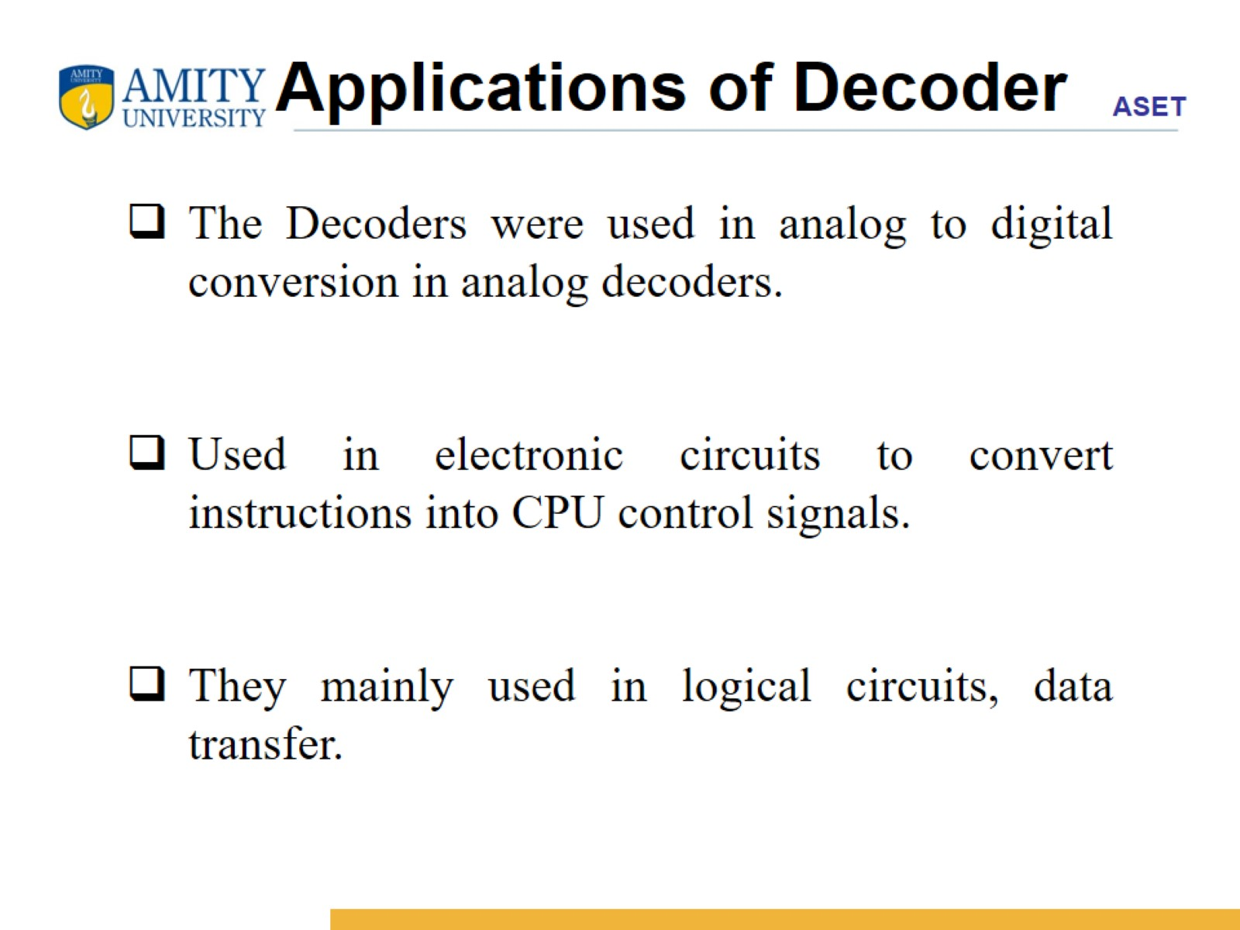
Applications of Decoder

Slide 18
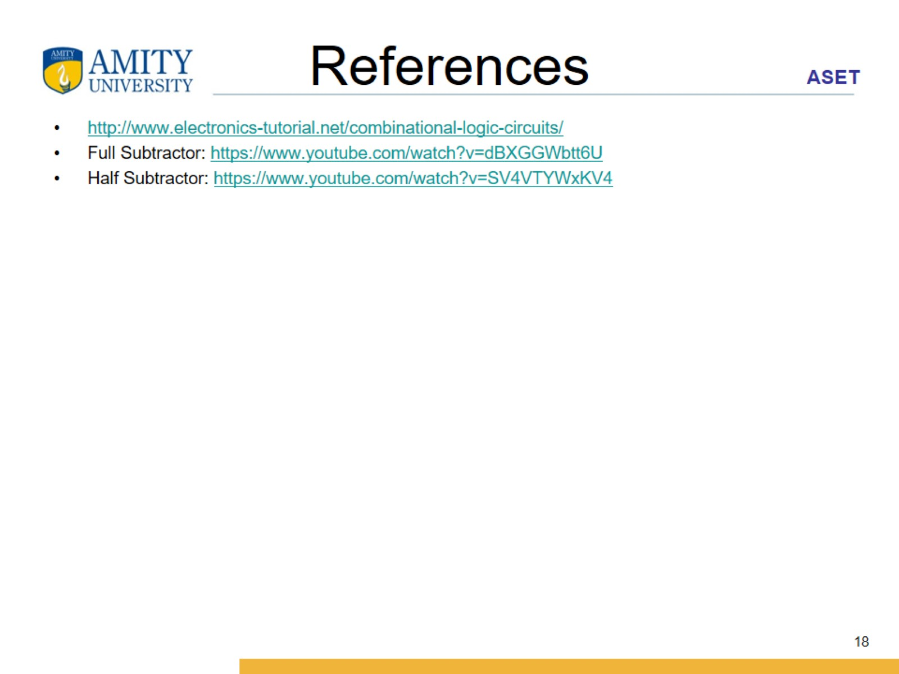
References

Slide 19
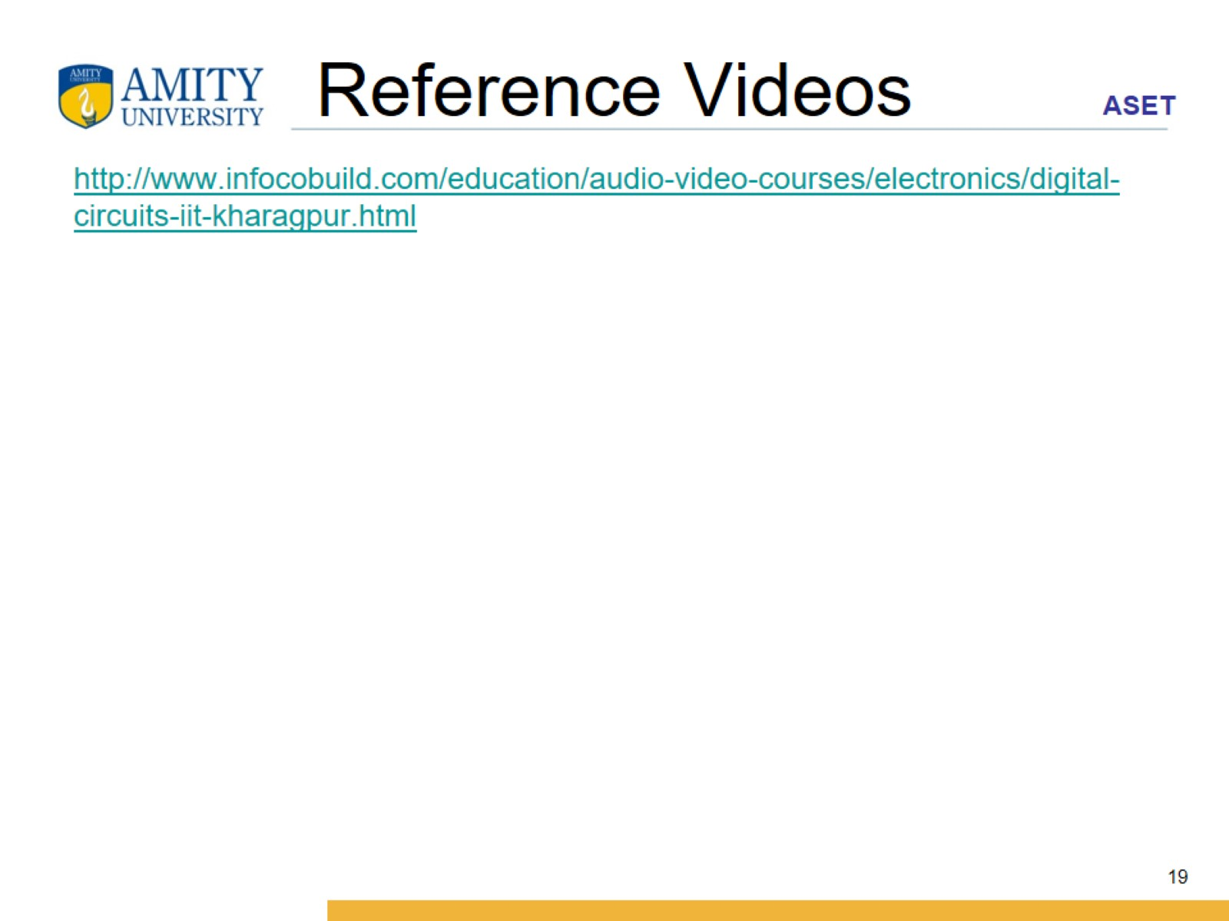
Reference Videos

